Slide 1


SOLID WASTE MANAGEMENT
BATCH-5

Slide 2


BATCH-5
T.Shanmukha Sudha Kiran
K.Sruthi Chowday
P.Vamsi
P.Amrutha
211FA04003
211FA04005
211FA04018
211FA04126

Slide 3

TITLE:
Assess on-site solid waste handling practice and its associated factors among the Ganga basin residents in Uttarakhand and Uttar Pradesh

Slide 4
AIM:
In this presentation we have discussed of on-site solid waste handling practices and its determinants among residents in the Ganga basin, specifically in Uttarakhand and Uttar Pradesh. Through a comprehensive survey and analysis, the research delves into the current waste management practices adopted by households, considering factors such as socio-economic status, education, and awareness. The study's findings shed light on the prevailing waste disposal methods, recycling behaviors, and community engagement in waste reduction. Ultimately, this research contributes essential insights to inform targeted interventions and policies aimed at improving solid waste management in the Ganga basin, promoting sustainable practices, and mitigating environmental challenges.

Slide 5

INTRODUCTION
Onsite solid waste definition:
On-site solid waste handling refers to the practices and methods individuals use to manage and dispose of their household waste directly at the point of generation, typically within their premises.
Onsite solid waste handling techniques:
These techniques include waste segregation, composting, recycling, and responsible disposal. Residents may sort waste into different categories, convert organic waste into compost, recycle materials like paper and plastic, and ensure proper disposal of non-recyclable or hazardous waste.

Slide 6

OBJECTIVES:
1)On-Site Practices Assessment: The presentation seeks to document and understand the various methods that residents employ to handle their household waste at the point of generation.
2)Factors Analysis: The Presentation aims to identify the factors influencing these waste handling practices. These factors could include socio-economic status, education, cultural norms, urban/rural context, waste collection infrastructure, awareness about environmental consequences, and community involvement.

Slide 7
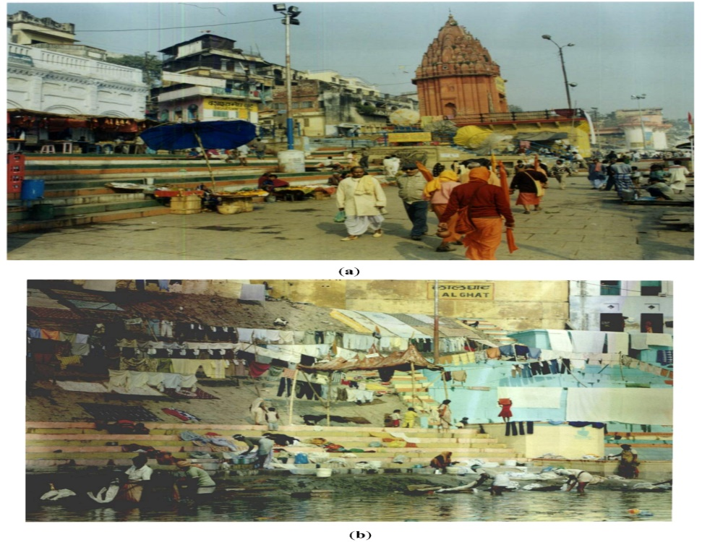
METHODOLOGY
The presentation will employ a mixed-methods approach, including surveys, interviews, and field observations, to gather data. Household surveys will collect information about waste handling methods used, frequency of disposal, segregation practices, and awareness levels.
Fig.1 waste disposal in ganga.

Slide 8

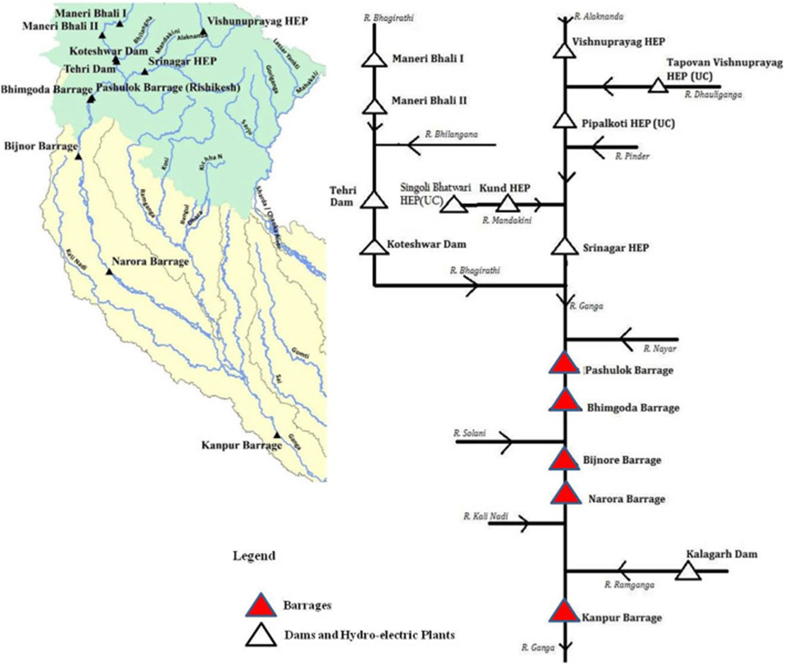
CONCLUSION:
By assessing on-site solid waste handling practices and exploring their associated factors, this study aims to provide valuable insights that can guide the development of effective waste management strategies, leading to cleaner and more environmentally sustainable communities within the Ganga basin region of Uttarakhand and Uttar Pradesh.

Slide 9
REFERENCES:
→https://www.ncbi.nlm.nih.gov/pmc/articles/PMC9899140/
→https://www.mdpi.com/2071-1050/4/8/1647
→https://www.irjet.net/archives/V9/i5/IRJET-V9I5752.pdf
→https://www.researchgate.net/publication/347777766_Solid_waste_management_in_rural_areas_nearby_river_Ganga_at_Haridwar_in_Uttarakhand_India

Slide 10

THANK YOU

